Slide 1

one microtask
primes another
Edward Newell
Derek Ruths
Network Dynamics Group
McGill University

Slide 2
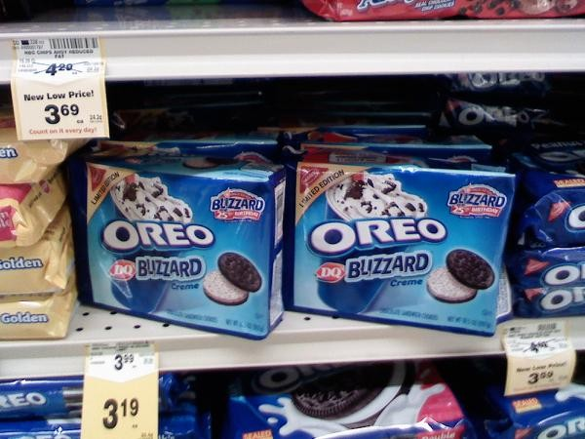

Slide 3
Priming can be strong

Slide 4
Priming can be strong
“Crime is a beast ...”
“Crime is a virus ...”
1. Rank the following solutions:
…

Slide 5
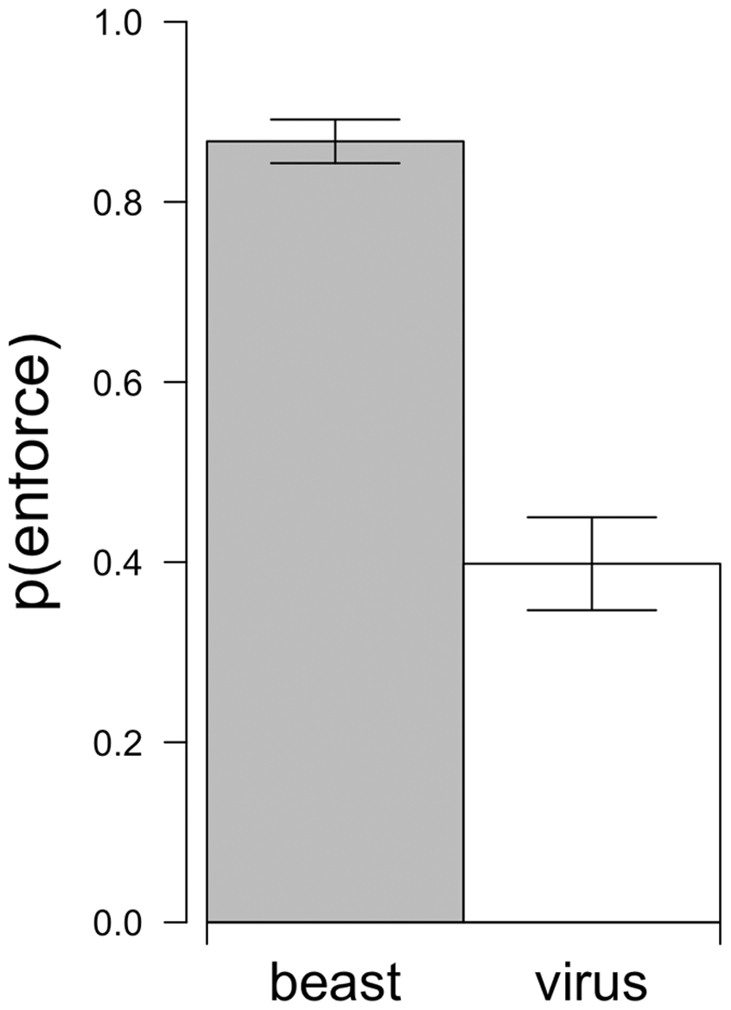
Priming can be strong

Slide 6
Framing
- vs -
Inter-task effects

Slide 7
A typical microtask setup

Slide 8
A typical microtask setup

Slide 9
A typical microtask setup
food
object

Slide 10
priming
A typical microtask setup
food
object

Slide 11
Inter-task effects
food pics
inter-task
object pics
“ food ”
framing
“ objects ”

Slide 12
Test tasks

Slide 13

Test task

Slide 14

Test task

Slide 15
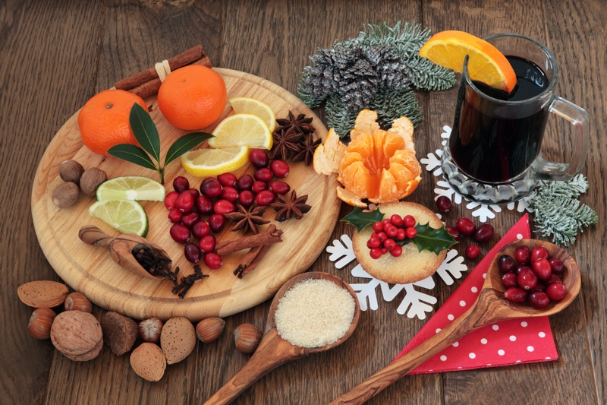
Test task

Slide 16
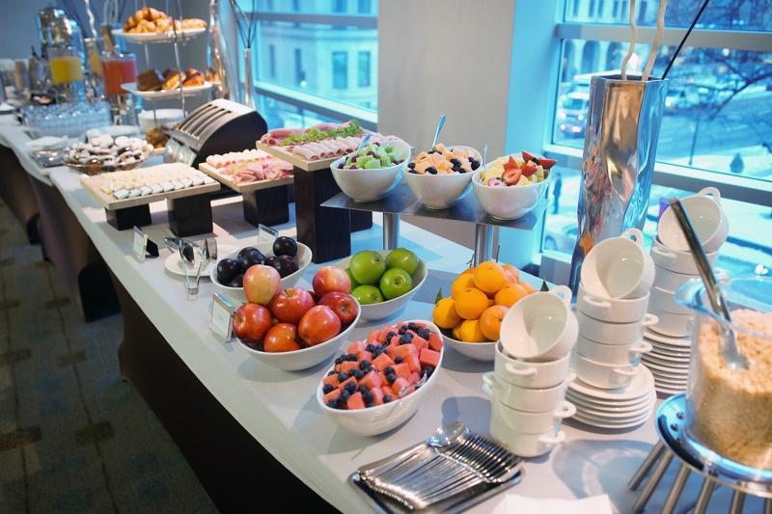
Test task

Slide 17

Test task

Slide 18
Initial tasks: food

Slide 19
Inter-task effects
food pics
inter-task
object pics
“ food ”
framing
“ objects ”

Slide 20
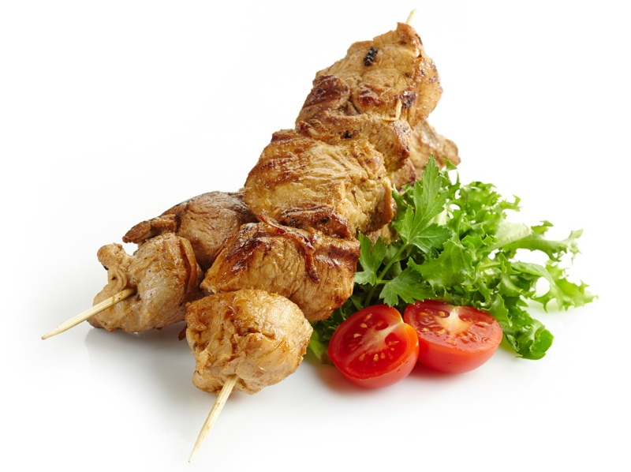
Initial tasks: food

Slide 21
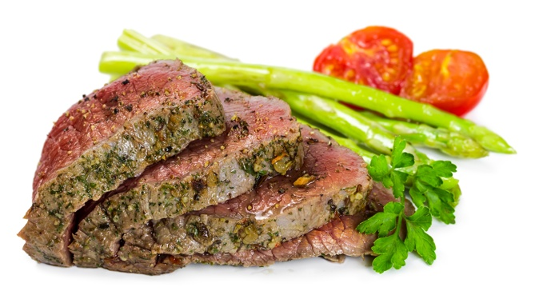
Initial tasks: food

Slide 22
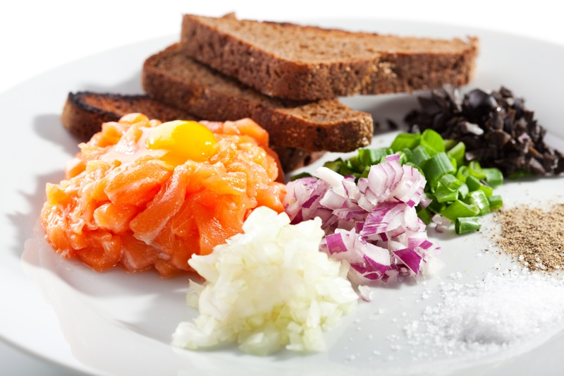
Initial tasks: food

Slide 23
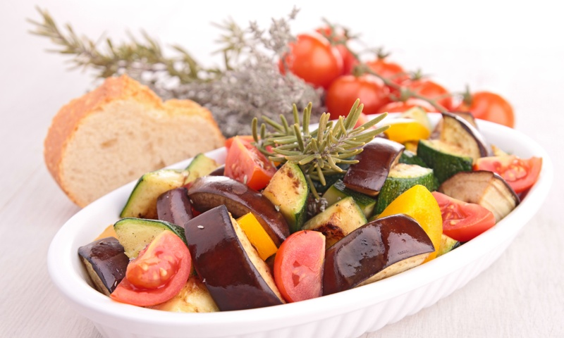
Initial tasks: food

Slide 24
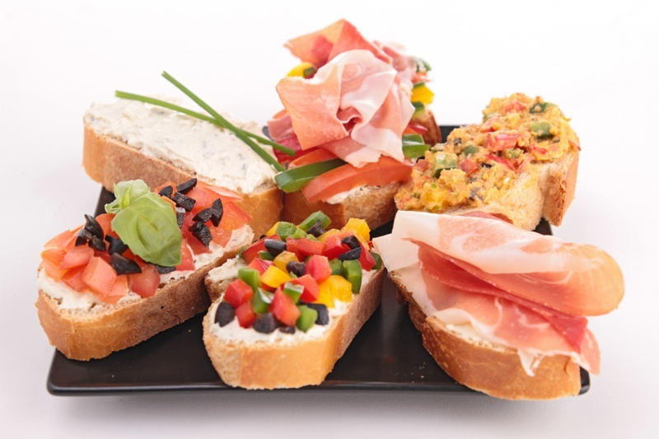
Initial tasks: food

Slide 25
Initial tasks: objects

Slide 26
Inter-task effects
food pics
inter-task
object pics
“ food ”
framing
“ objects ”

Slide 27

Initial tasks: objects

Slide 28

Initial tasks: objects

Slide 29

Initial tasks: objects

Slide 30

Initial tasks: objects

Slide 31

Initial tasks: objects

Slide 32
Inter-task effects
food pics
inter-task
object pics
“ food ”
framing
“ objects ”

Slide 33
Framing
The purpose of this study is to understand the visual perception of
Food and Ingredients
The purpose of this study is to understand the visual perception of
Objects and Tools

Slide 34
How strong are inter-task effects compared to priming?

Slide 35
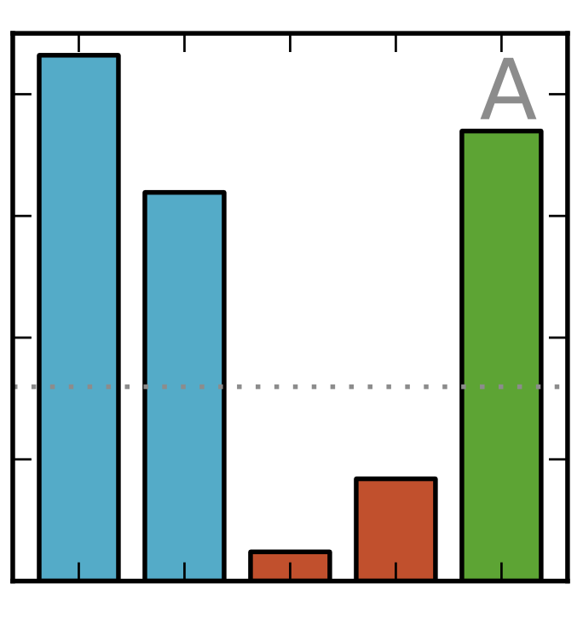
Inter-task effects: stronger than framing
40
30
% Bias
20
10
*
task1
task2
frame1
frame2

Slide 36
How do inter-task effects vary through time?

Slide 37
Inter-task effects
food pics
inter-task
object pics
“ food ”
framing
“ objects ”

Slide 38
Inter-task effects
food pics
1
2
3
4
5
inter-task
object pics
“ food ”
framing
“ objects ”

Slide 39
Inter-task effects: decay over time
40
30
% Bias
20
10

Slide 40
What are the effects, qualitatively?

Slide 41
What are the effects, qualitatively?
directs focus?

Slide 42
Inter-task effects: direct focus
30
20
% food labels
10
*
task1
frame1
task2
frame2

Slide 43
What are the effects, qualitatively?
specificity

Slide 44
Inter-task effects
30
20
+% vocabulary
10

Slide 45
Inter-task effects
food pics
inter-task
object pics
“ food ”
framing
“ objects ”

Slide 46
What can we do with this?
Tune HPUs granularity

Slide 47
What can we do with this?
Tune HPUs granularity
Heighten sensitivity, specificity
Notes:
negative priming
we can heighten sensitivity to particular differences

Slide 48
What can we do with this?
Tune HPUs granularity
Heighten sensitivity, specificity
Achieve expert performance
Notes:
- part of expertise is knowing what details to focus on

Slide 49
What can we do with this?
Tune HPUs granularity
Heighten sensitivity, specificity
Achieve expert performance
Simultaneously test and re-prime

Slide 50
What can we do with this?
Tune HPUs granularity
Heighten sensitivity, specificity
Achieve expert performance
Simultaneously test and re-prime
Sustain recall for imbalanced data
Notes:
epilepsy from eeg

Slide 51
What can we do with this?
Tune HPUs granularity
Heighten sensitivity, specificity
Achieve expert performance
Simultaneously test and re-prime
Sustain recall for imbalanced data
Don’t train, prime!

Slide 52
What can we do with this?
Tune HPUs granularity
Heighten sensitivity, specificity
Achieve expert performance
Simultaneously test and re-prime
Sustain recall for imbalanced data
Don’t train, prime!
A universal measurement of bias

Slide 53
What can we do with this?
Tune HPUs granularity
Heighten sensitivity, specificity
Achieve expert performance
Simultaneously test and re-prime
Sustain recall for imbalanced data
Don’t train, prime!
A universal measurement of bias
edward.newell@gmail.com
Notes:
we can make HPU’s both more and less specific

Slide 54
How to measure priming?
R

Slide 55
How to measure priming?
R
prime
δ⁺
δ⁻

Slide 56
How to measure priming?
R
prime
δ⁺
δ⁻
task
T
T

Slide 57
How to measure priming?
R
prime
δ⁺
δ⁻
task
T
T
output
P
Q

Slide 58
How to measure priming?
D(P,Q)

Slide 59
How to measure priming?
D(P,Q)
?

Slide 60
How to measure priming?
D(P,Q)
?
χ² (chi squared)

Slide 61
How to measure priming?
D(P,Q)
?
χ² (chi squared)
Kulback-Liebler
Shannon-Jenson
L₁-distance

Slide 62
How to measure priming?
hpu output
a binary decision

Slide 63
How to measure priming?
hpu output
a binary decision

Slide 64
How to measure priming?
hpu output
a binary decision

Slide 65
How to measure priming?
hpu output
“ bias ”
a binary decision

Slide 66
How to measure priming?
How should priming be measured?
if( ) {
…
} else {
…
}

Slide 67
How to measure priming?

Slide 68
How to measure priming?

Slide 69
How to measure priming?
find the most susceptible decision

Slide 70
How to measure priming?
find the most susceptible decision
“max bias”

Slide 71
How to measure priming?
max bias

Slide 72
How to measure priming?
max bias
L₁-distance

Slide 73
How to measure priming?
max bias
L₁-distance
accuracy of best classifier

Slide 74
Inter-task effects
T₁
T₂
prime?

Slide 75
Jenson-Shannon Divergence

Slide 77
Variance
Stochastic
Systematic

Slide 78

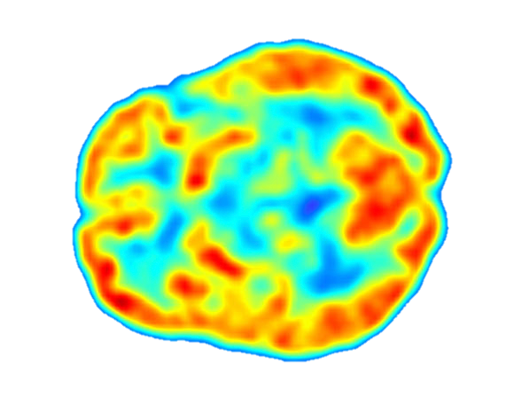
Variance
Stochastic
Systematic
Selection
Priming

Slide 79
Variance
Stochastic
Systematic
Selection
Priming
framing
inter-task
effects

Slide 80
Priming
?
?
?
Psychological
Computational

Slide 81
References

Slide 82
References

Slide 83
References

Slide 84
References

Slide 85
References

